Slide 1
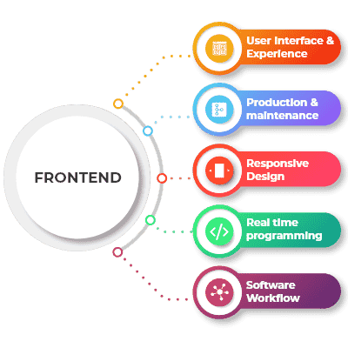



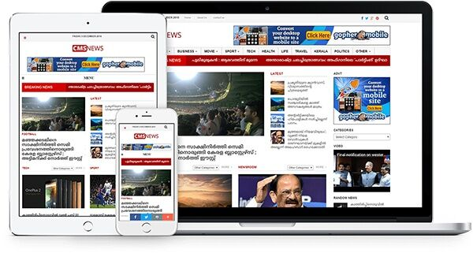
Complete News Web
Solutions
Dated: 01 March 2025 V1.0
"Your Vision, Our Innovation – Together, We Build the Future!"
💡 Got an idea? TACHY turns it into reality.
✅ Custom News Website Design: Tailored layouts and features that reflect your brand and meet your audience’s needs. ✅ Seamless Content Management: Robust CMS integration to empower effortless publishing, editing, and content curation. ✅ Scalable & Responsive Solutions: Optimized performance across all devices with future growth in mind. ✅ Integrated Multimedia & Social Tools: Effortlessly manage multimedia content and social media sharing to boost engagement. ✅ Advanced SEO & Analytics: Built-in optimization and tracking to enhance visibility and measure impact. ✅ End-to-End Development Expertise: From initial consultation to launch and beyond, our team handles every aspect of development.
email: info@tachy.com | Web : www.tachy.in |

Slide 2
Query -
1. Project Objectives & Vision
Define the primary purpose of the website (information dissemination, engagement, revenue generation).
Identify the target audience and their needs.
2. Content Strategy
Determine the types of news content (local, national, international, niche topics).
Decide on content formats (articles, videos, podcasts, infographics).
3. Design & User Experience
Establish branding guidelines (logo, color scheme, typography).
Outline the desired layout and overall design style.
Identify key pages (homepage, article pages, category sections, archives, about, contact).
4. Core Features & Functionality
Content Management System (CMS): Preference for an existing platform or a custom-built solution.
User Interactivity: Options for user registration, commenting, social sharing, and newsletter subscriptions.
Search & Navigation: Efficient categorization, tagging, and search functionality.
Multimedia Integration: Support for images, videos, and interactive content.
"Your Vision, Our Innovation – Together, We Build the Future!"
💡 Got an idea? TACHY turns it into reality.
email: info@tachy.com | Web : www.tachy.in |

Slide 3
Query -
5. Technical & Security Requirements
Performance & Scalability: Anticipated traffic and future growth.
Responsive Design: Compatibility across desktops, tablets, and mobile devices.
SEO & Analytics: Integration of SEO best practices and analytics tools.
Security: Protocols for user data protection and content security.
6. Administration & Content Workflow
Define roles and permissions for content creators, editors, and administrators.
Establish content creation, review, and publishing workflows.
Plan for handling breaking news and time-sensitive updates.
7. Integration & Monetization
Third-Party Integrations: Social media, RSS feeds, email newsletter tools, ad platforms.
Monetization Strategy: Options for subscriptions, ad placements, and sponsored content.
8. Timeline & Budget
Outline key project milestones and launch dates.
Discuss initial budget estimates for design, development, and maintenance.
"Your Vision, Our Innovation – Together, We Build the Future!"
💡 Got an idea? TACHY turns it into reality.
email: info@tachy.com | Web : www.tachy.in |

